Slide 1
Efficient Algorithms
Ekkapot Charoenwanit
Software Systems Engineering
TGGS
KMUTNB

Slide 2
Lecture 5: Searching and Sorting

Slide 3
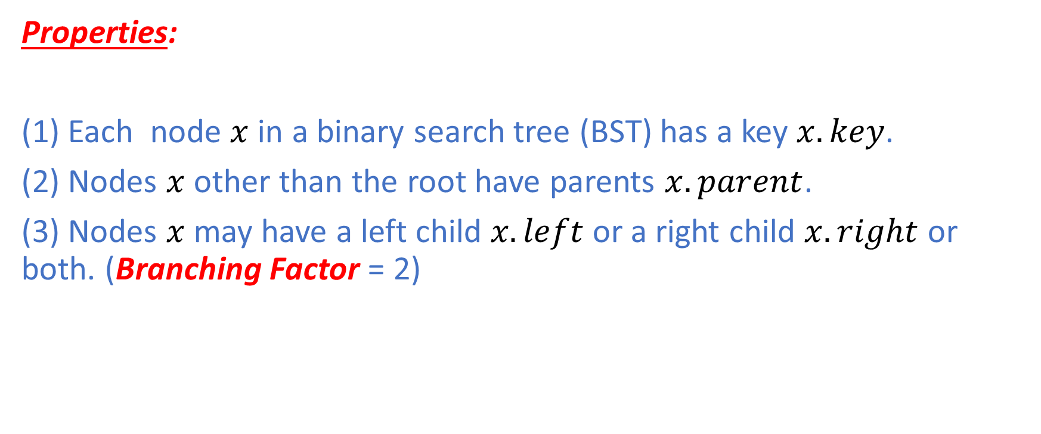
Binary Search Tree: Properties
Properties:
(1) Each node $x$ in a binary search tree (BST) has a key $x.key$.
(2) Nodes $x$other than the root have parents $x.parent$.
(3) Nodes $x$ may have a left child $x.left$or a right child $x.right$ or both. (Branching Factor = 2)

Slide 4
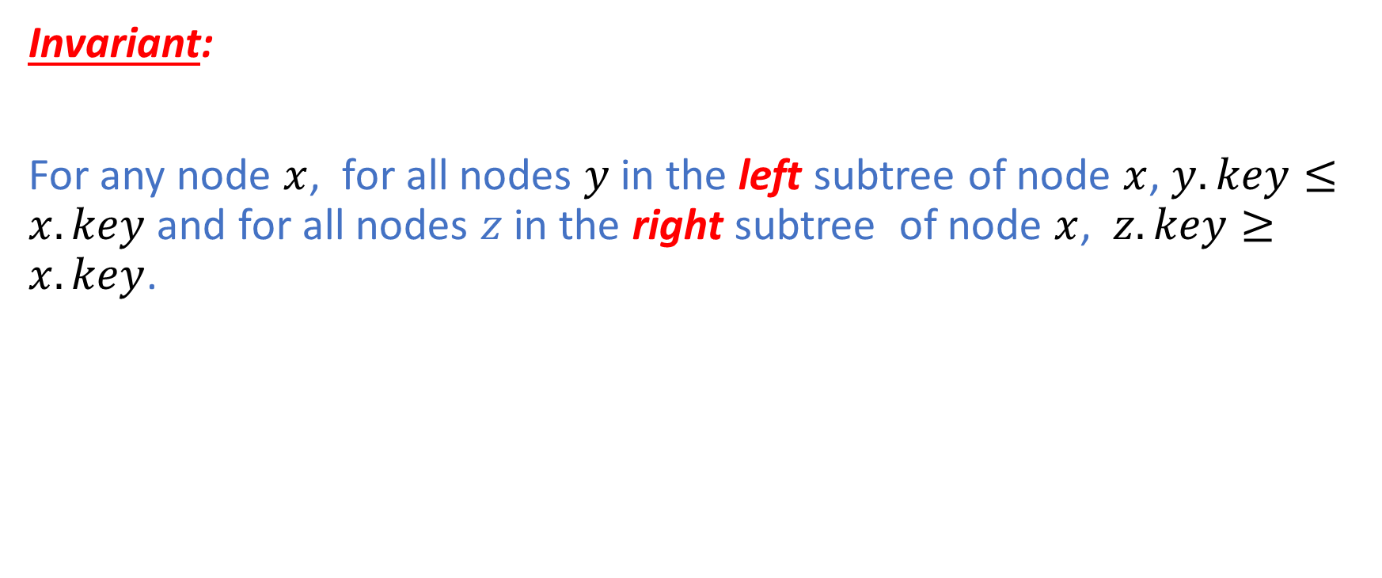
Binary Search Tree: Invariant
Invariant:
For any node $x$, for all nodes $y$in the left subtree of node $x$, $y.key≤x.key$ and for all nodes $z$ in the right subtree of node $x$, $z.key≥x.key$.

Slide 5
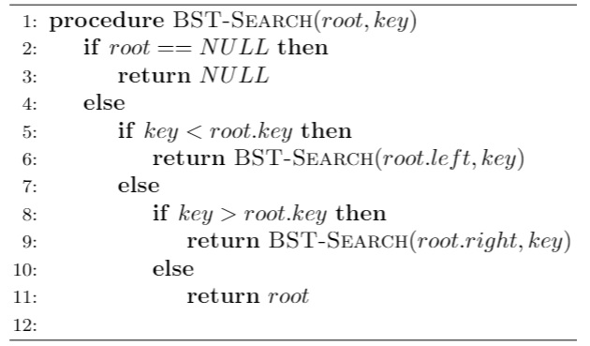


Binary Search Tree: Search
The running time of the search operation is $O(h)$, where $h$ is the height of the tree.

Slide 6
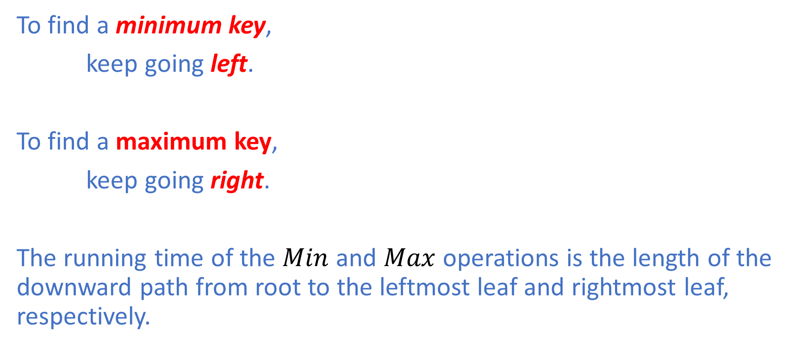
Binary Search Tree: Min and Max
To find a minimum key,
keep going left.
To find a maximum key,
keep going right.
The running time of the $Min$ and $Max$operations is the length of the downward path from root to the leftmost leaf and rightmost leaf, respectively.

Slide 7
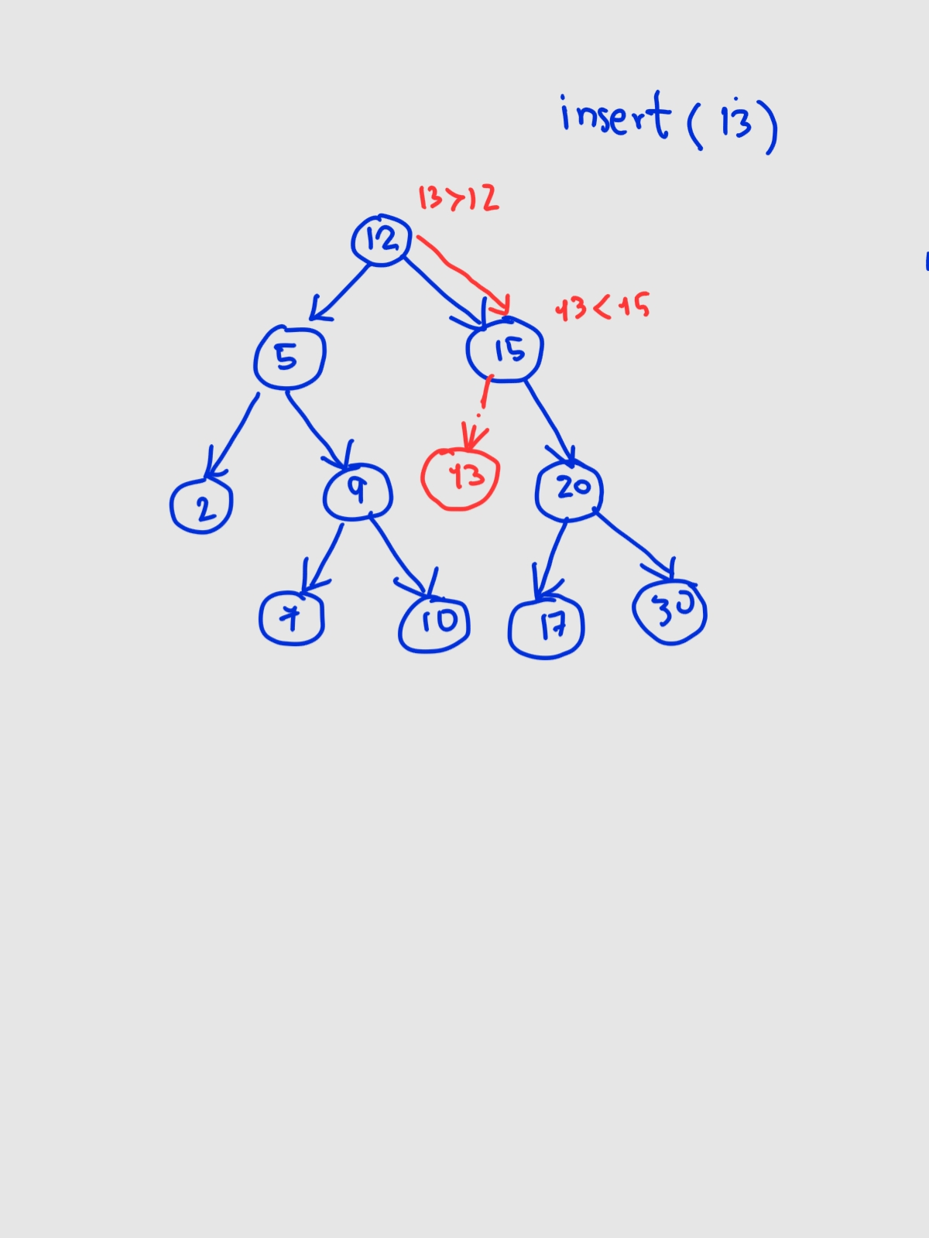
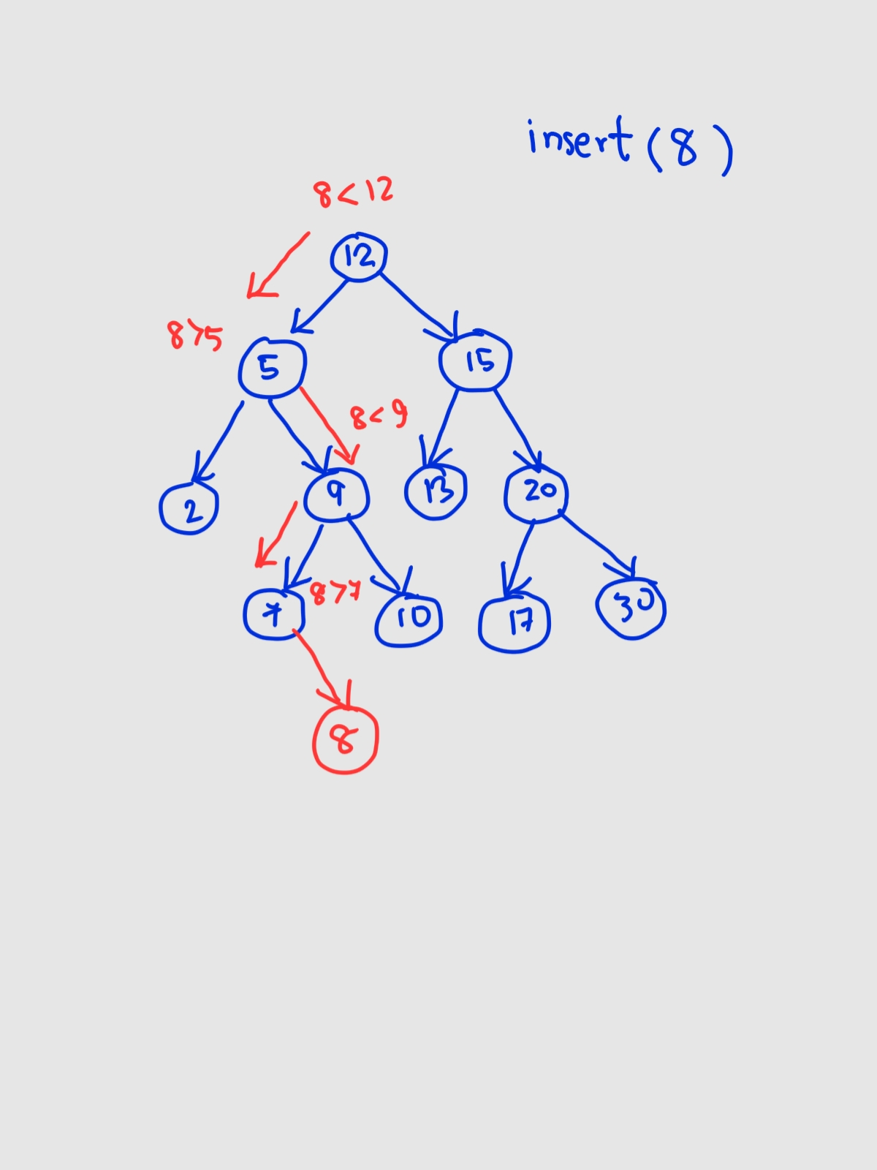
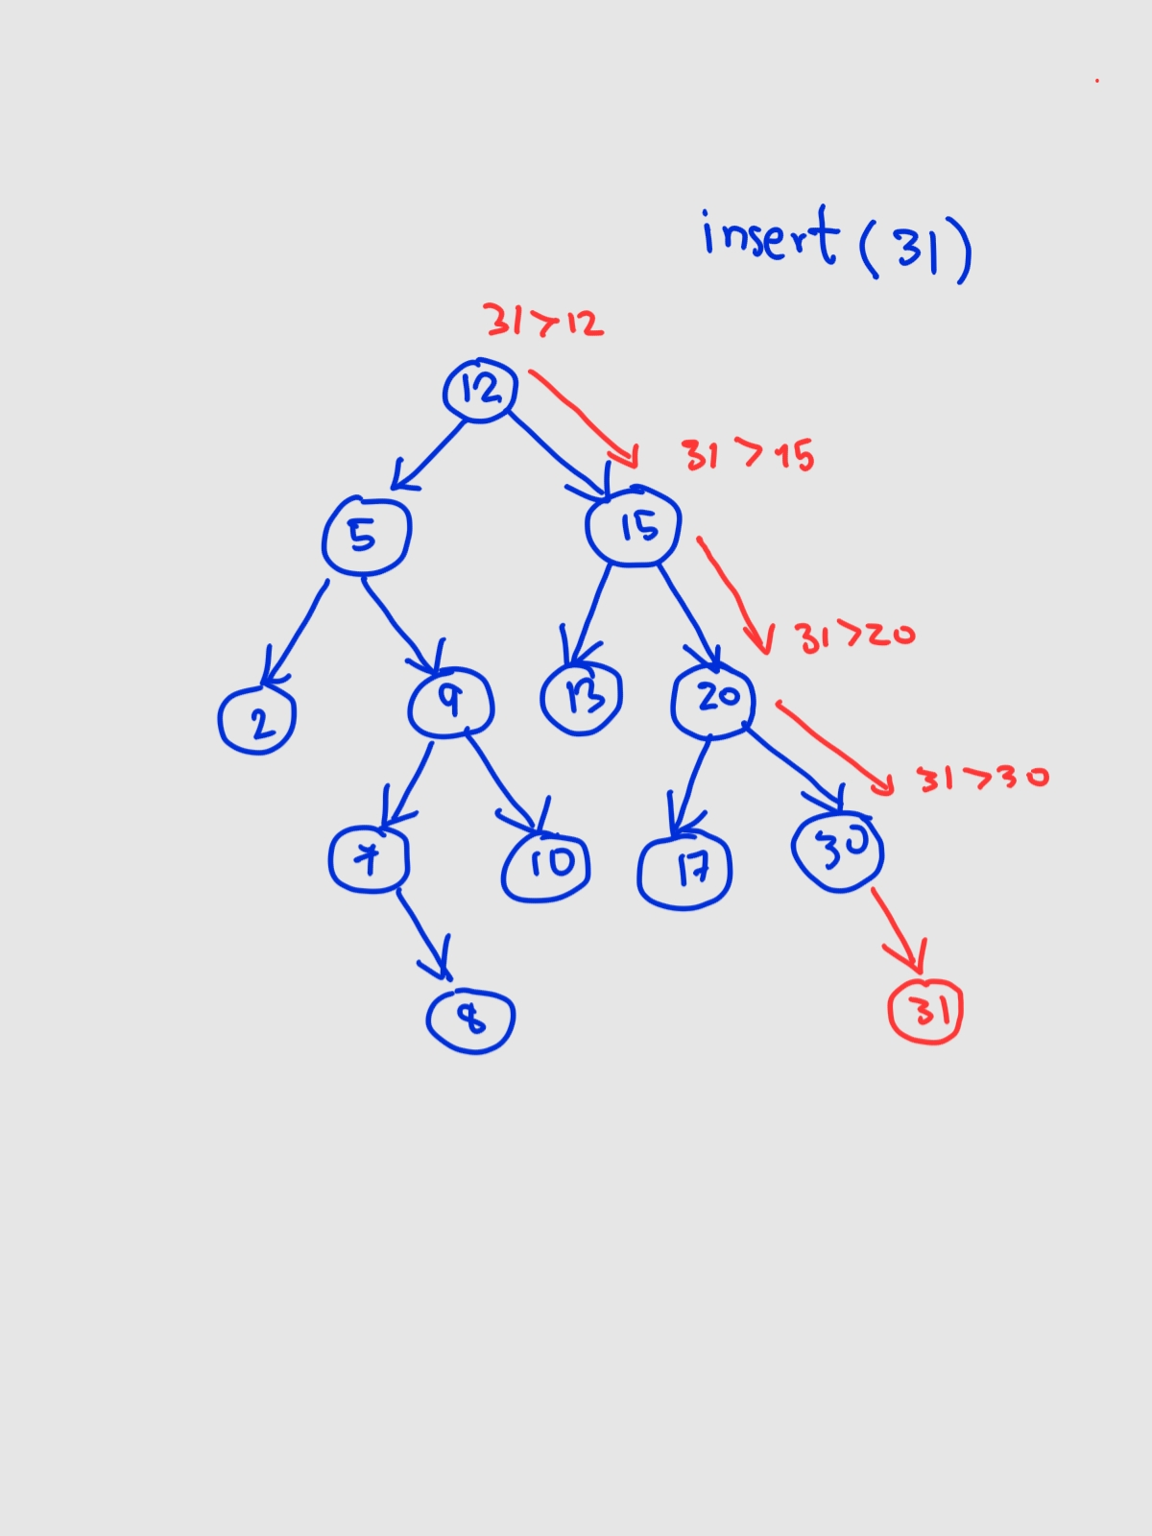
Binary Search Tree: Insert
Follow the left and right pointers until the right position for the key being inserted is found.

Slide 8
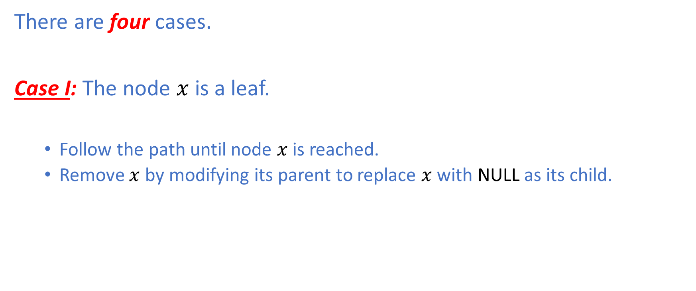
Binary Search Tree: Delete
There are four cases.
Case I: The node $x$ is a leaf.
Follow the path until node $x$ is reached.
Remove $x$ by modifying its parent to replace $x$with NULL as its child.

Slide 9
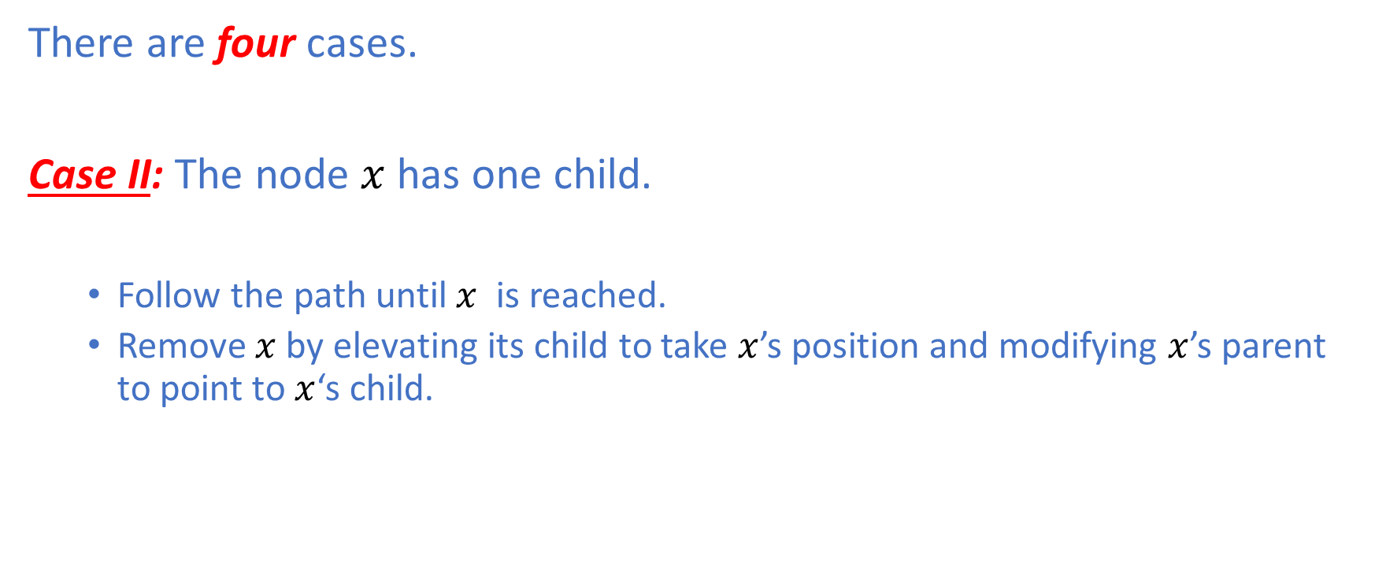
Binary Search Tree: Delete
There are four cases.
Case II: The node $x$ has one child.
Follow the path until $x$ is reached.
Remove $x$by elevating its child to take $x$’s position and modifying $x$’s parent to point to $x$‘s child.

Slide 10
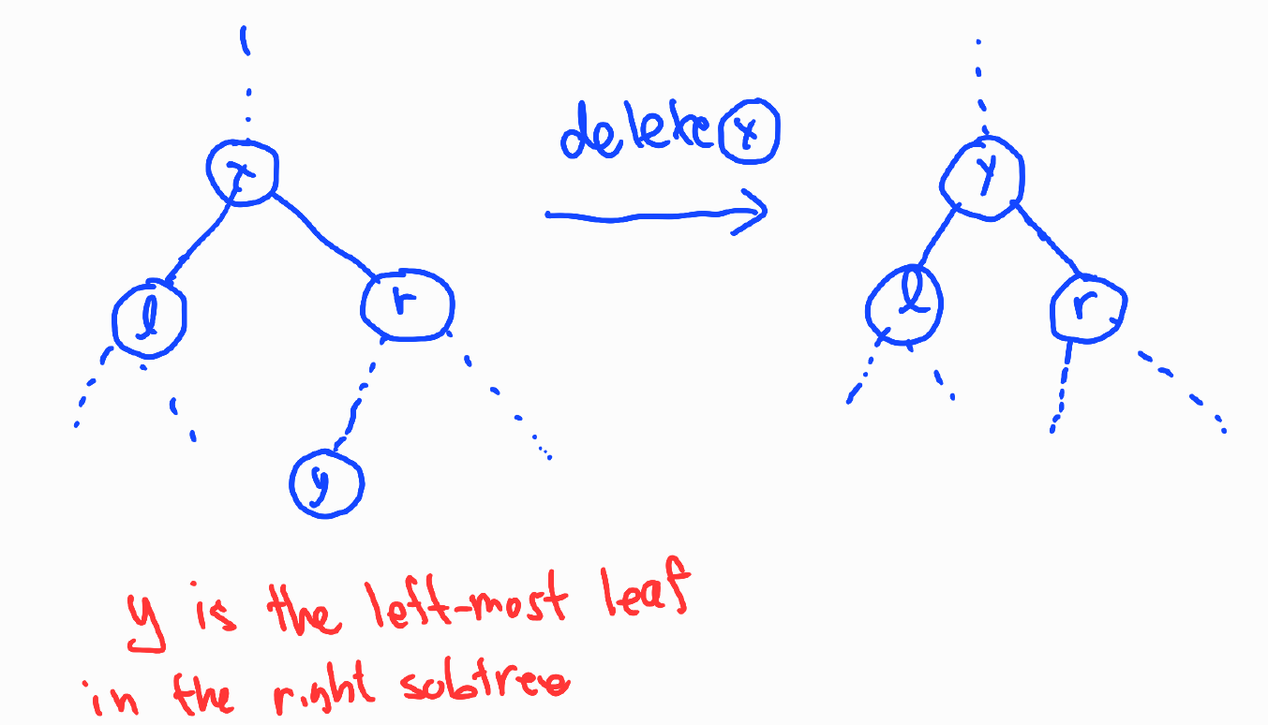
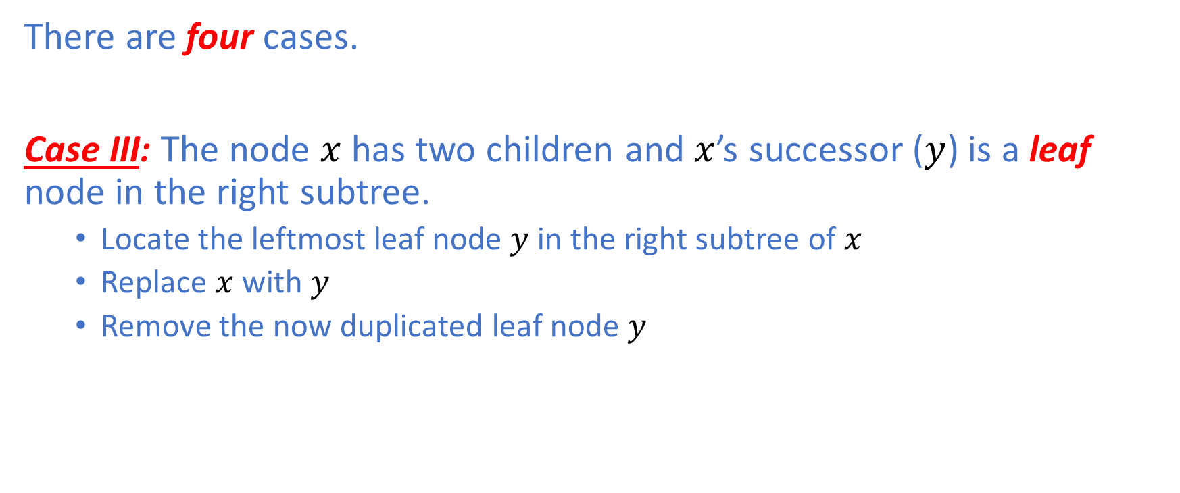
Binary Search Tree: Delete
There are four cases.
Case III: The node $x$ has two children and $x$’s successor ($y$) is a leaf node in the right subtree.
Locate the leftmost leaf node $y$ in the right subtree of $x$
Replace $x$ with $y$
Remove the now duplicated leaf node $y$

Slide 11
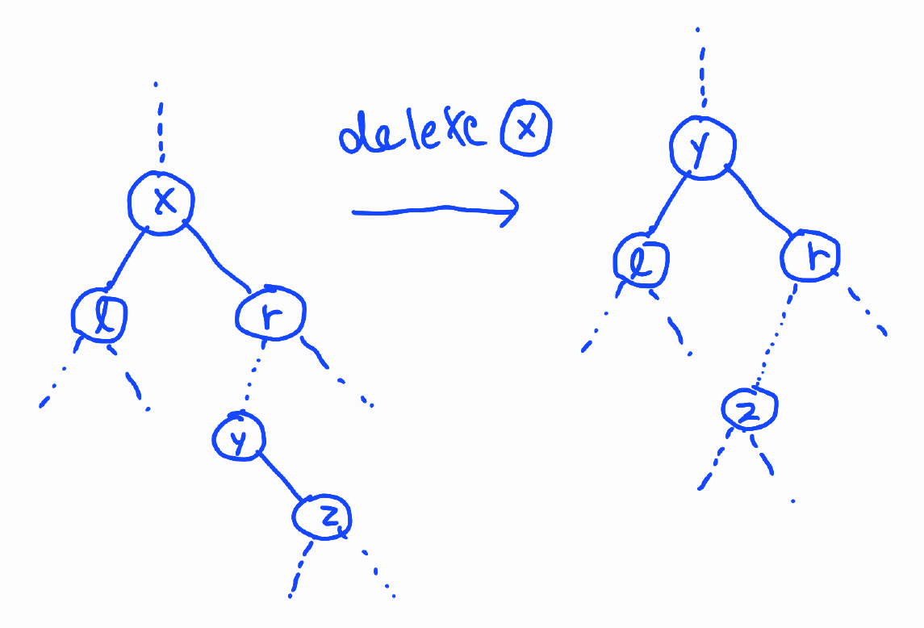
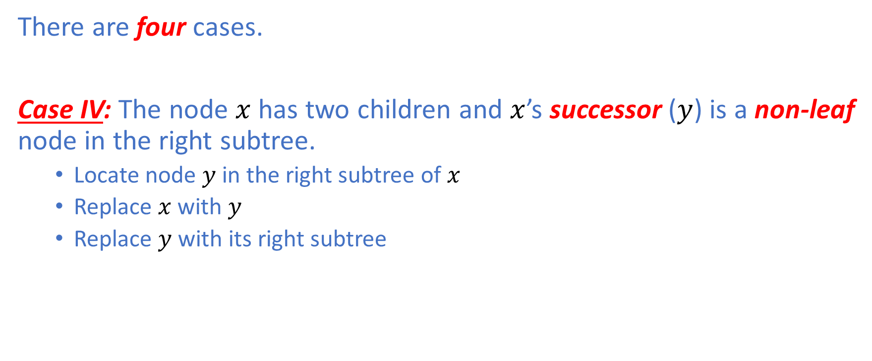
Binary Search Tree: Delete
There are four cases.
Case IV: The node $x$ has two children and $x$’s successor ($y$) is a non-leaf node in the right subtree.
Locate node $y$ in the right subtree of $x$
Replace $x$ with $y$
Replace $y$ with its right subtree

Slide 12
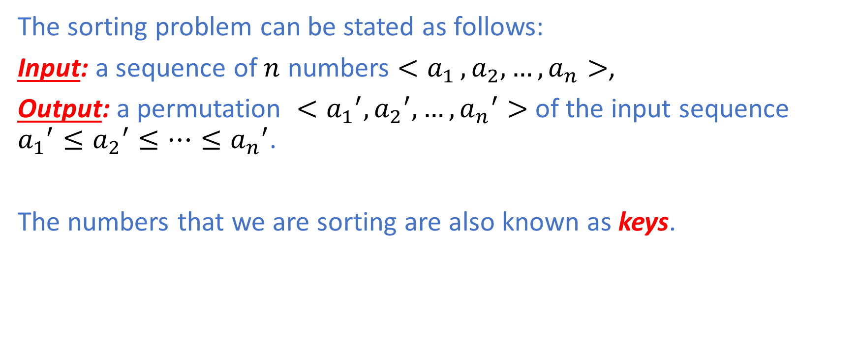
The Sorting Problem
The sorting problem can be stated as follows:
Input: a sequence of $n$ numbers $<a_{1 },a_{2},…,a_{n}>$,
Output: a permutation $<{a_{1}}^{′},{a_{2}}^{′},…,{a_{n}}^{′}>$ of the input sequence ${a_{1}}^{′}≤{a_{2}}^{′}≤…≤{a_{n}}^{′}$.
The numbers that we are sorting are also known as keys.

Slide 13
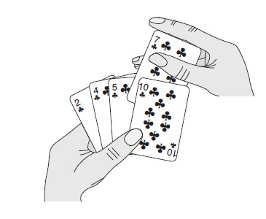
Insertion Sort
Idea:
Imagine the way we sort a hand of playing cards.
We start with an empty hand with the cards facing down on the table
We pick up one card at a time from the table
We insert the new card into the correct position in the left hand
To find the correct position, we compare the new card with the existing cards in the hand, from left to right.
Illustration taken from CLRS

Slide 14
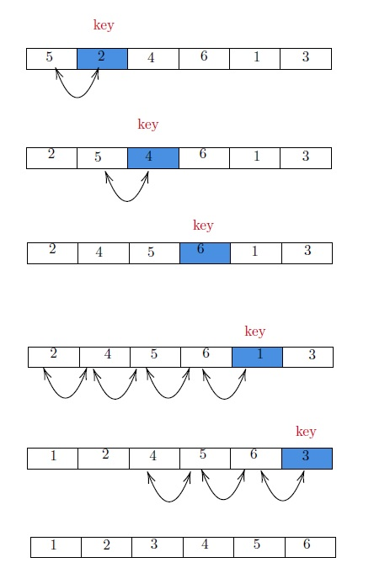
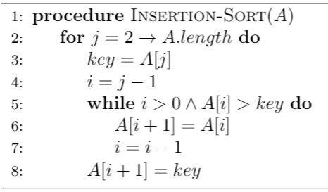
Insertion Sort

Slide 15
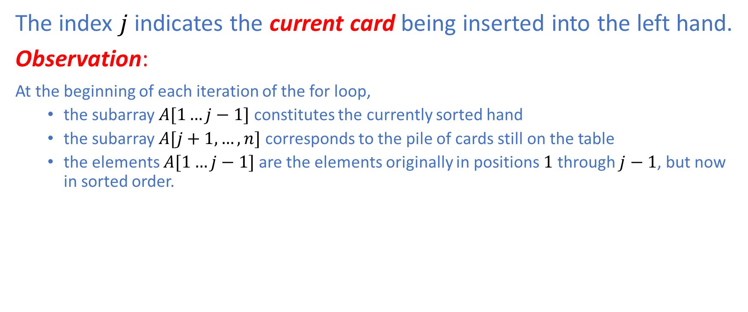
Insertion Sort
The index $j$ indicates the current card being inserted into the left hand.
Observation:
At the beginning of each iteration of the for loop,
the subarray $A[1…j−1]$ constitutes the currently sorted hand
the subarray $A[j+1,…,n]$ corresponds to the pile of cards still on the table
the elements $A[1…j−1]$ are the elements originally in positions $1$ through $j−1$, but now in sorted order.

Slide 16
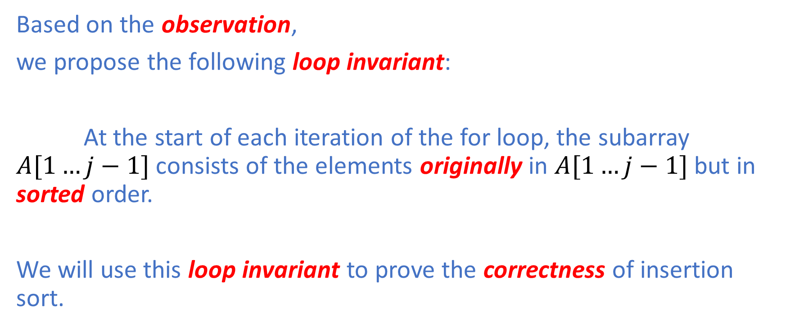
Insertion Sort: Correctness Proof
Based on the observation,
we propose the following loop invariant:
At the start of each iteration of the for loop, the subarray $A[1…j−1]$ consists of the elements originally in $A[1…j−1]$ but in sorted order.
We will use this loop invariant to prove the correctness of insertion sort.

Slide 17
Loop Invariant
Initialization: The invariant is true prior to the first iteration of the loop.
Maintenance: If the invariant is true before an iteration of the loop, it remains true before the next iteration.
Termination: When the loop terminates, the invariant provides a useful property that can be used to show that the algorithm is correct.

Slide 18
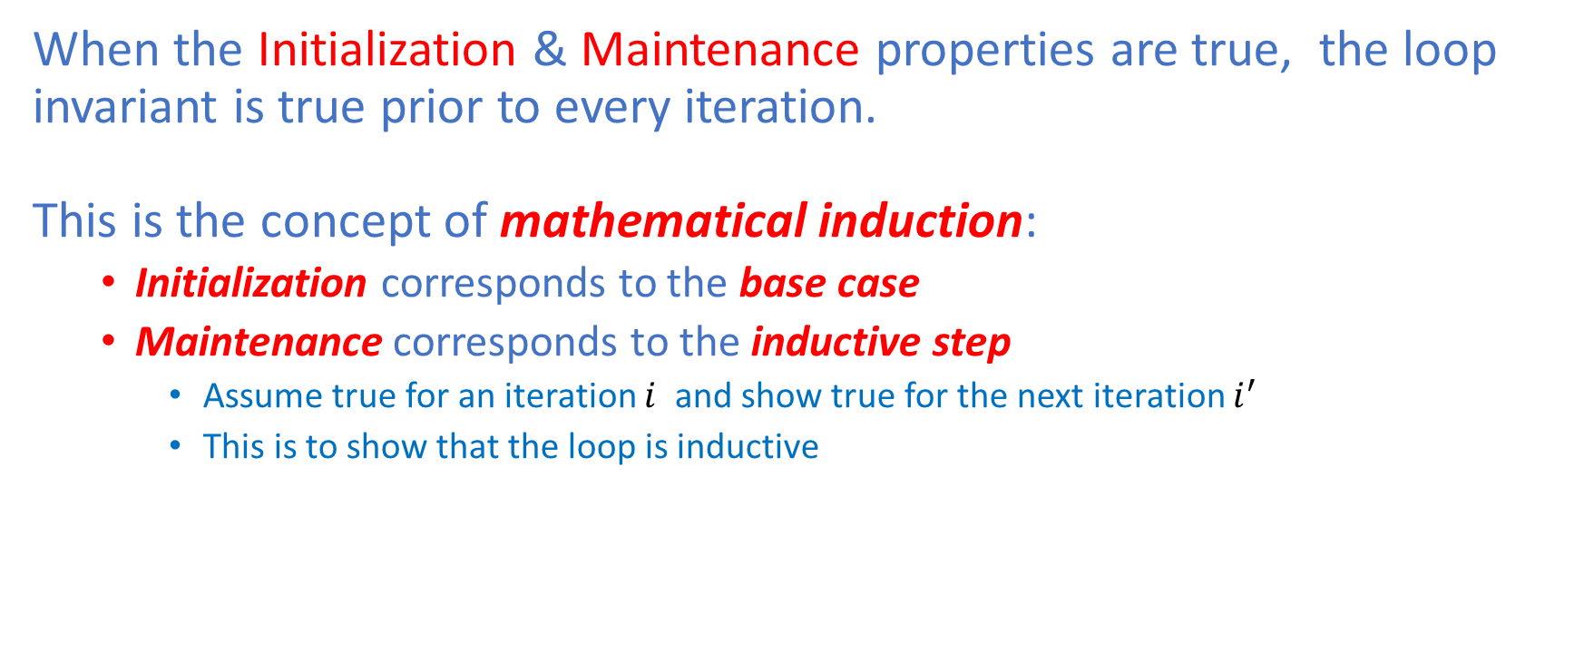
Loop Invariant
When the Initialization & Maintenance properties are true, the loop invariant is true prior to every iteration. This is the concept of mathematical induction:
Initialization corresponds to the base case
Maintenance corresponds to the inductive step
Assume true for an iteration $i$ and show true for the next iteration $i^{′}$
This is to show that the loop is inductive
The Termination property differs from how we use mathematical induction where we apply the inductive step infinitely.
At termination, we stop the induction and use the invariant to show that the algorithm is correct.

Slide 19
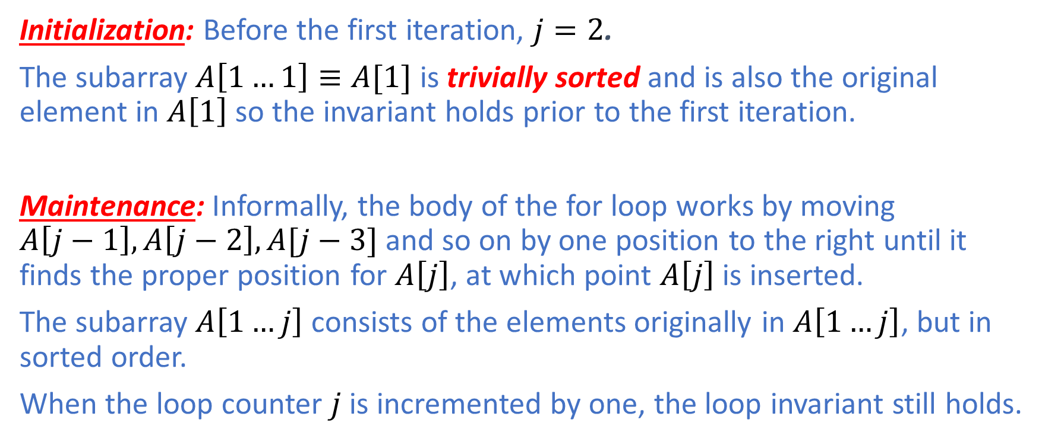
Insertion Sort: Loop Invariant
Initialization: Before the first iteration, $j=2$.
The subarray $A\left[1…1\right]≡A[1]$ is trivially sorted and is also the original element in $A\left[1\right]$ so the invariant holds prior to the first iteration.
Maintenance: Informally, the body of the for loop works by moving $A\left[j−1\right],A\left[j−2\right],A[j−3]$ and so on by one position to the right until it finds the proper position for $A\left[j\right]$, at which point $A\left[j\right]$ is inserted.
The subarray $A\left[1…j\right]$ consists of the elements originally in $A\left[1…j\right]$, but in sorted order.
When the loop counter $j$ is incremented by one, the loop invariant still holds.

Slide 20
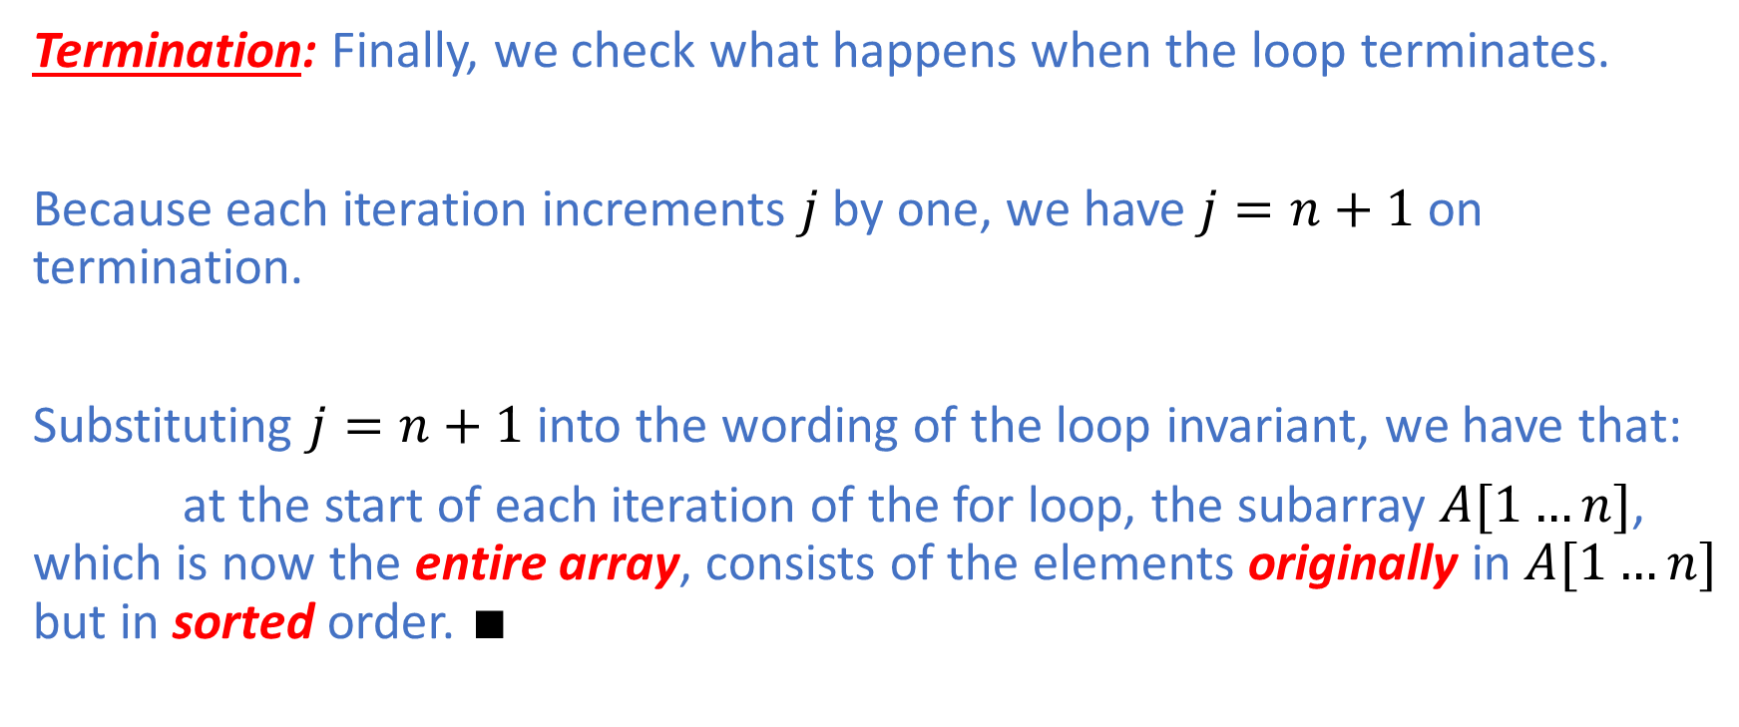
Insertion Sort: Termination
Termination: Finally, we check what happens when the loop terminates.
Because each iteration increments $j$ by one, we have $j=n+1$ on termination.
Substituting $j=n+1$ into the wording of the loop invariant, we have that:
at the start of each iteration of the for loop, the subarray $A[1…n]$, which is now the entire array, consists of the elements originally in $A[1…n]$ but in sorted order. $∎$

Slide 21
Insertion Sort: Running Time Analysis
Barometer Instruction:
We count the total number of comparisons
This corresponds to Line 5

Slide 22
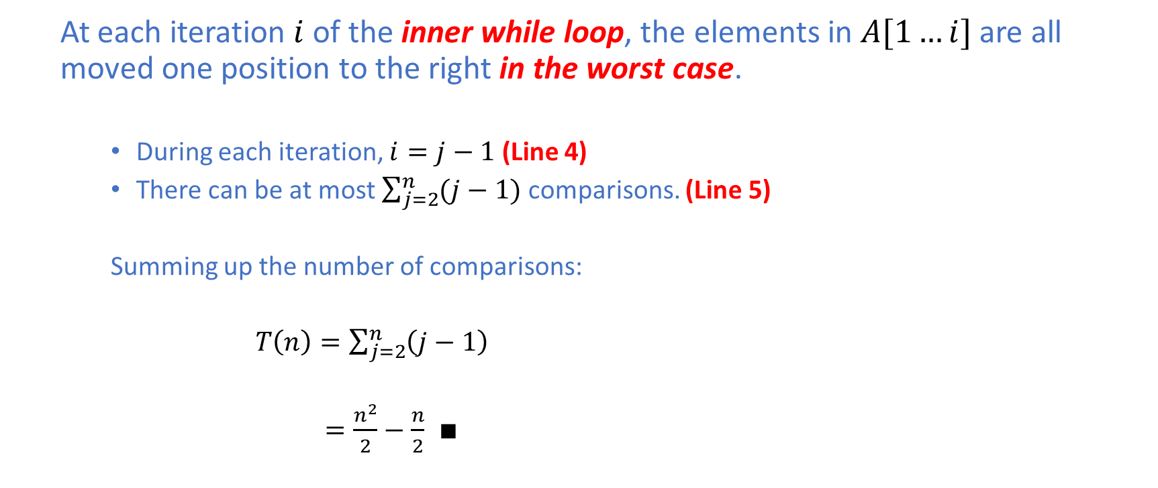
Insertion Sort: Worst-Case Analysis
At each iteration $i$ of the inner while loop, the elements in $A[1…i]$ are all moved one position to the right in the worst case.
During each iteration, $i=j−1$ (Line 4)
There can be at most $\sum_{j=2}^{n}{(j−1)}$ comparisons. (Line 5)
Summing up the number of comparisons:
$T\left(n\right)=\sum_{j=2}^{n}{\left(j−1\right)}$
$=\frac{n^{2}}{2}−\frac{n}{2}$ $∎$

Slide 23
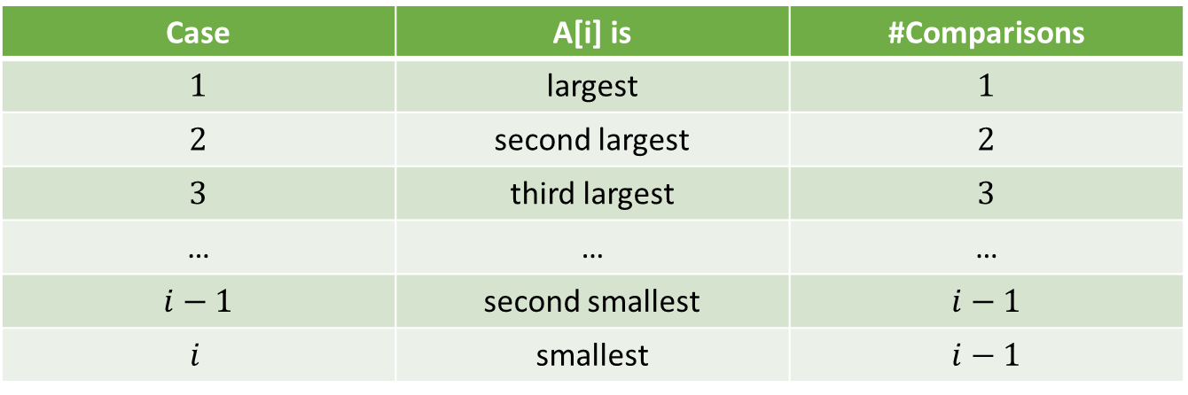

Insertion Sort: Average-Case Analysis
For a given iteration $i$, there are $i$ possible cases as follows:
Case | A[i] is | #Comparisons
$1$ | largest | $1$
$2$ | second largest | $2$
$3$ | third largest | $3$
… | … | …
$i−1$ | second smallest | $i−1$
$$i$$ | smallest | $i−1$

Slide 24
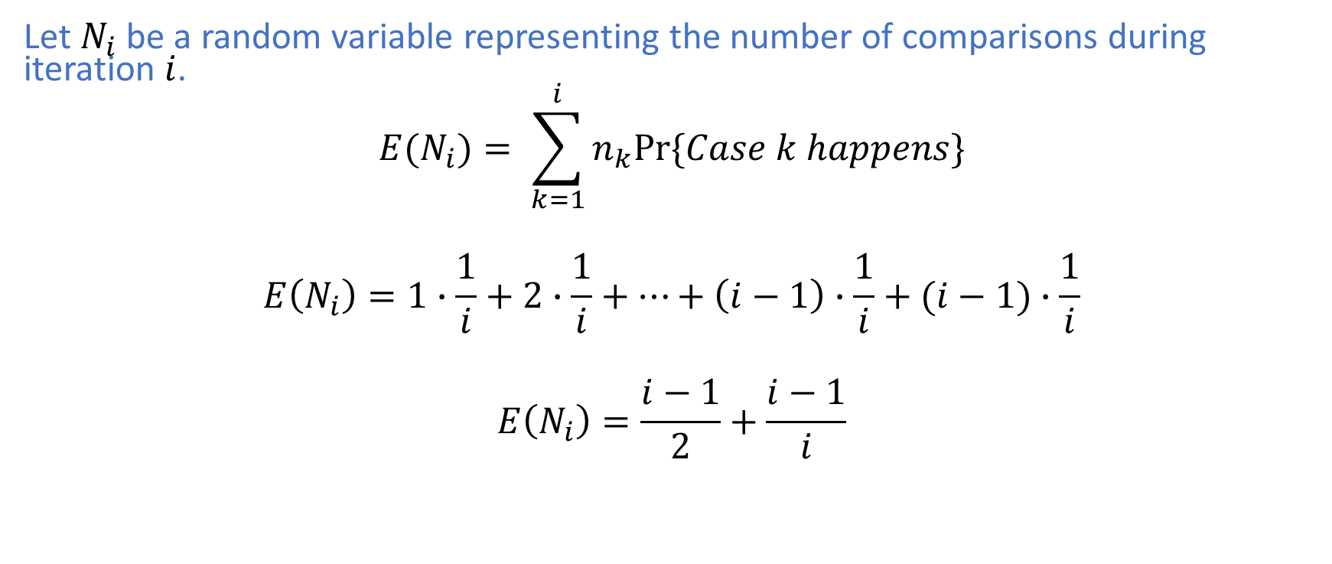
Insertion Sort: Average-Case Analysis
Let $N_{i}$ be a random variable representing the number of comparisons during iteration $i$.
$$E(N_{i})= \sum_{k=1}^{i}{n_{k}Pr⁡\{Case k happens\}}$$
$$E\left(N_{i}\right)=1∙\frac{1}{i}+2∙\frac{1}{i}+…+\left(i−1\right)∙\frac{1}{i}+(i−1)∙\frac{1}{i}$$
$$E\left(N_{i}\right)=\frac{i−1}{2}+\frac{i−1}{i}$$

Slide 25
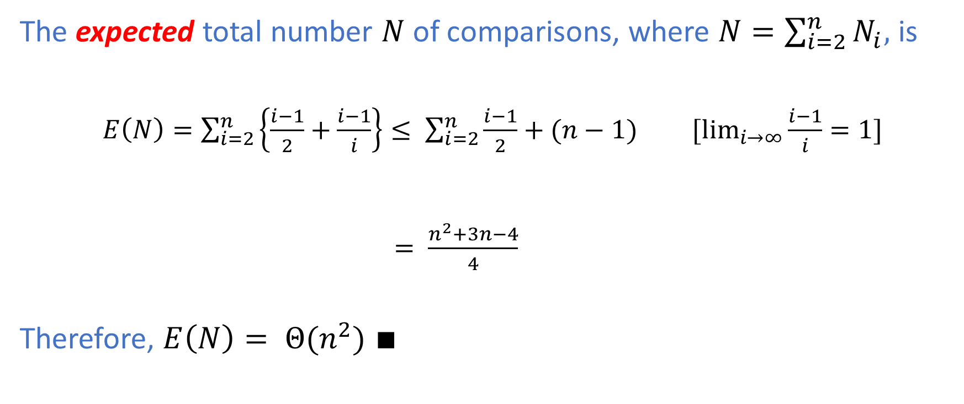
Insertion Sort: Average-Case Analysis
The expected total number $N$ of comparisons, where $N=\sum_{i=2}^{n}{N_{i}}$, is
$E\left(N\right)=\sum_{i=2}^{n}{\left\{\frac{i−1}{2}+\frac{i−1}{i}\right\}≤ \sum_{i=2}^{n}{\frac{i−1}{2}}}+(n−1)$ $[\lim_{i→∞}{\frac{i−1}{i}}=1]$
$= \frac{n^{2}+3n−4}{4}$
Therefore, $E\left(N\right)= Θ(n^{2})$ $∎$

Slide 26

Insertion Sort: in-place algorithm
It is worth noting that insertion sort is an in-place algorithm in which $O(1)$ auxiliary storage is required to store intermediate results during the execution of the sorting algorithm.
Line 3 indicates that the variable $key$is the auxiliary space used by insertion sort.

Slide 27
Merge Sort
Idea: Merge sort is a divide-and-conquer algorithm
Divide the array into two subarrays of (approximately the same size) if the array size is larger than one → Divide
Sort each subarray (recursively) → Conquer
Merge the sorted two subarrays → Combine

Slide 28
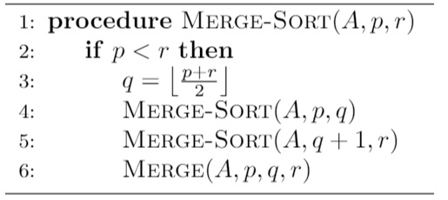
Merge Sort
Merge sort has several interesting properties as follows:
The divide and conquer parts are very simple
The combine part is (computationally) complex

Slide 29
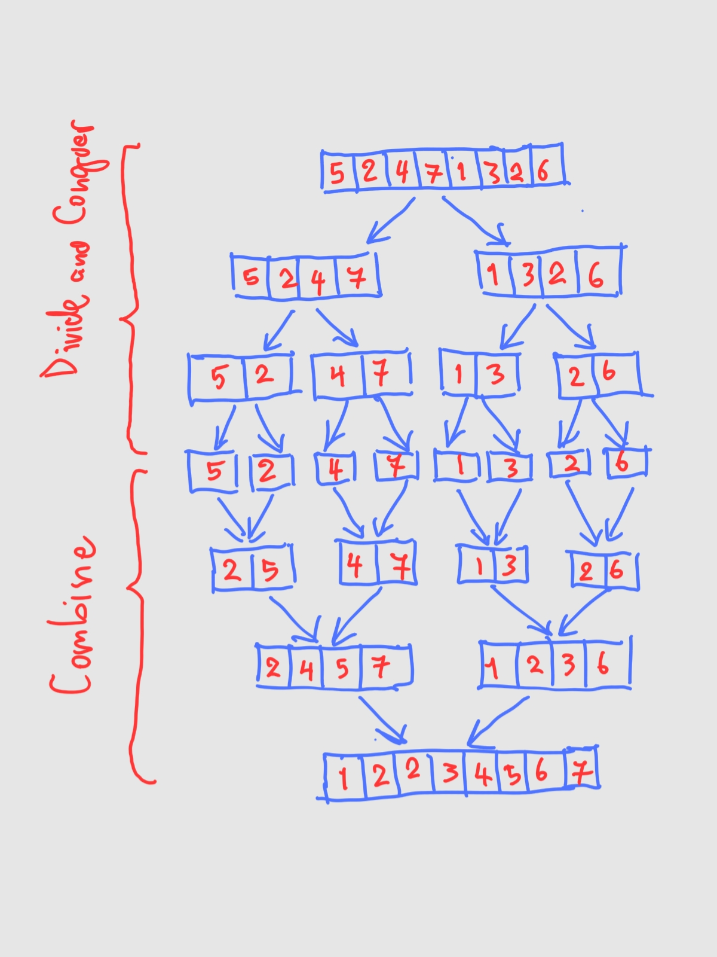
Merge Sort: Example
The divide and conquer parts are very simple
The combine part is (computationally) complex

Slide 30
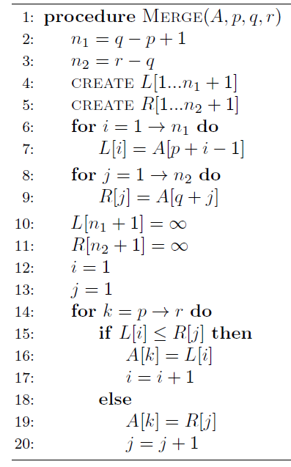
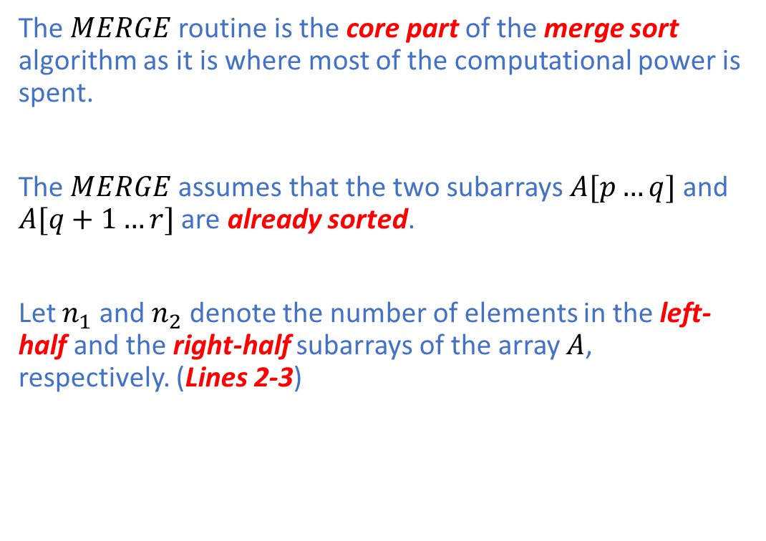
Merge Sort: Merge
The $MERGE$routine is the core part of the merge sort algorithm as it is where most of the computational power is spent.
The $MERGE$assumes that the two subarrays $A[p…q]$ and $A[q+1…r]$ are already sorted.
Let $n_{1}$ and $n_{2}$ denote the number of elements in the left-half and the right-half subarrays of the array $A$, respectively. (Lines 2-3)

Slide 31
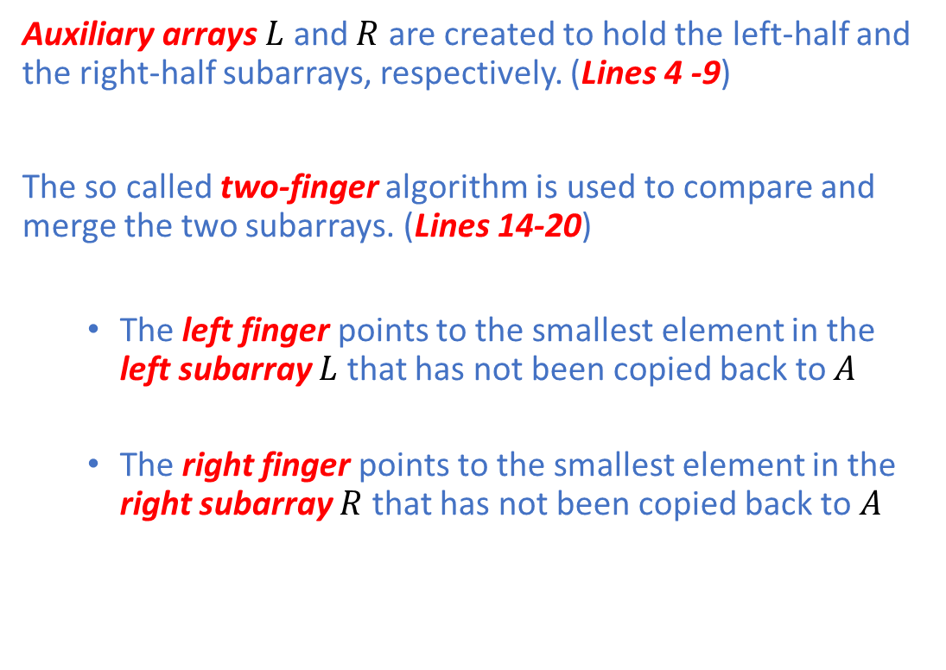
Merge Sort: Merge
Auxiliary arrays $L$ and $R$ are created to hold the left-half and the right-half subarrays, respectively. (Lines 4 -9)
The so called two-finger algorithm is used to compare and merge the two subarrays. (Lines 14-20)
The left finger points to the smallest element in the left subarray $L$ that has not been copied back to $A$
The right finger points to the smallest element in the right subarray $R$ that has not been copied back to $A$

Slide 32
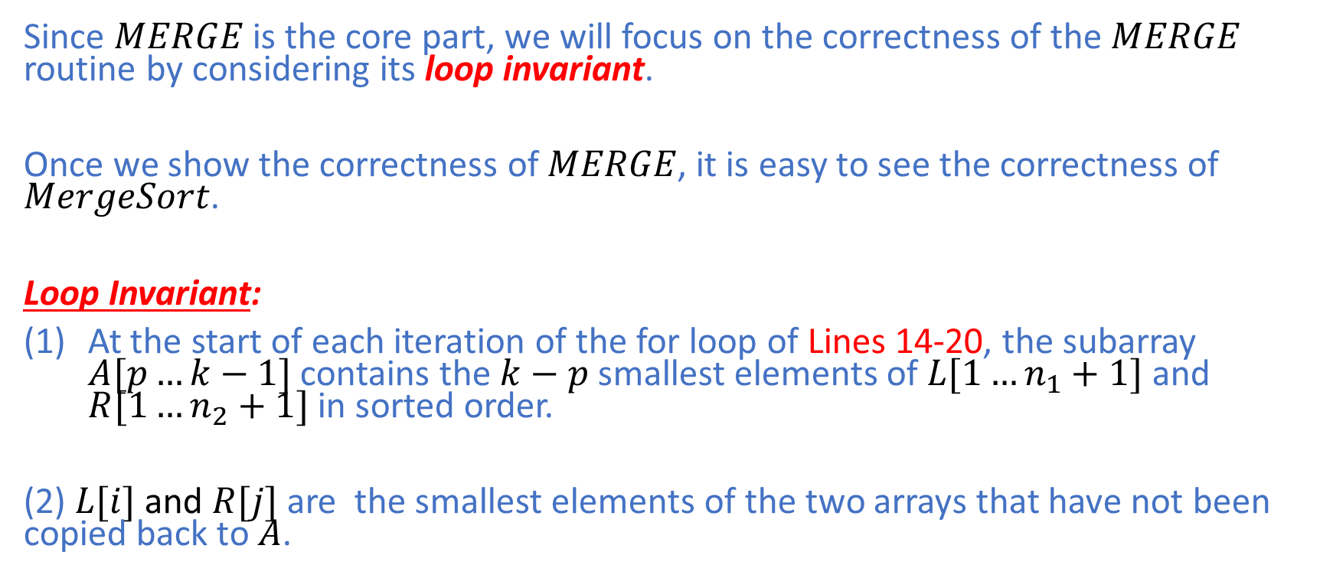
Merge Sort: Proof of Correctness
Since $MERGE$is the core part, we will focus on the correctness of the $MERGE$ routine by considering its loop invariant.
Once we show the correctness of $MERGE$, it is easy to see the correctness of $MergeSort$.
Loop Invariant:
At the start of each iteration of the for loop of Lines 14-20, the subarray $A[p…k−1]$ contains the $k−p$ smallest elements of $L[1…n_{1}+1]$ and $R[1…n_{2}+1]$ in sorted order.
(2) $L[i]$ and $R[j]$ are the smallest elements of the two arrays that have not been copied back to $A$.

Slide 33
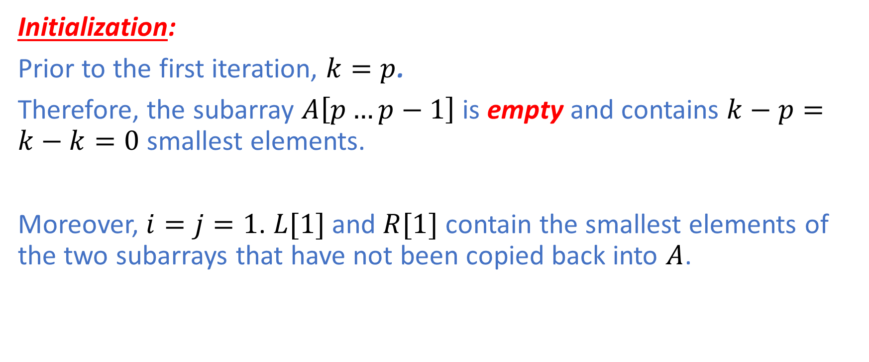
Merge Sort: Proof of Correctness
Initialization:
Prior to the first iteration, $k=p$.
Therefore, the subarray $A\left[p…p−1\right]$ is empty and contains $k−p=k−k=0$ smallest elements.
Moreover, $i=j=1$. $L[1]$ and $R[1]$ contain the smallest elements of the two subarrays that have not been copied back into $A$.

Slide 34
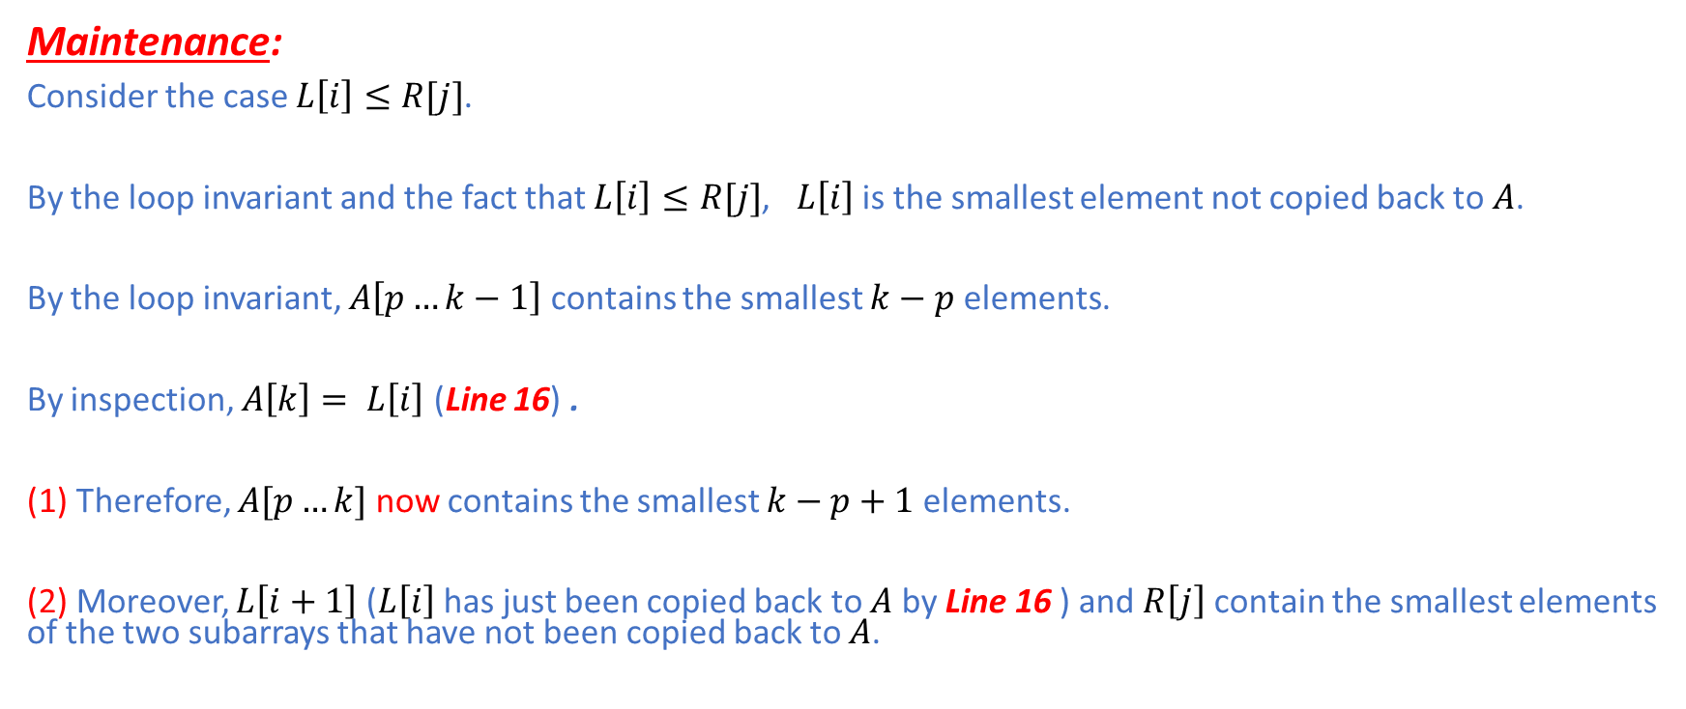
Merge Sort: Proof of Correctness
Maintenance:
Consider the case $L\left[i\right]≤R[j]$.
By the loop invariant and the fact that $L\left[i\right]≤R[j]$, $L\left[i\right]$ is the smallest element not copied back to $A$.
By the loop invariant, $A\left[p…k−1\right]$ contains the smallest $k−p$ elements.
By inspection, $A\left[k\right]= L\left[i\right]$ (Line 16) .
(1) Therefore, $A[p…k]$ now contains the smallest $k−p+1$ elements.
(2) Moreover, $L\left[i+1\right]$ ($L\left[i\right]$ has just been copied back to $A$ by Line 16 ) and $R\left[j\right]$ contain the smallest elements of the two subarrays that have not been copied back to $A$.

Slide 35
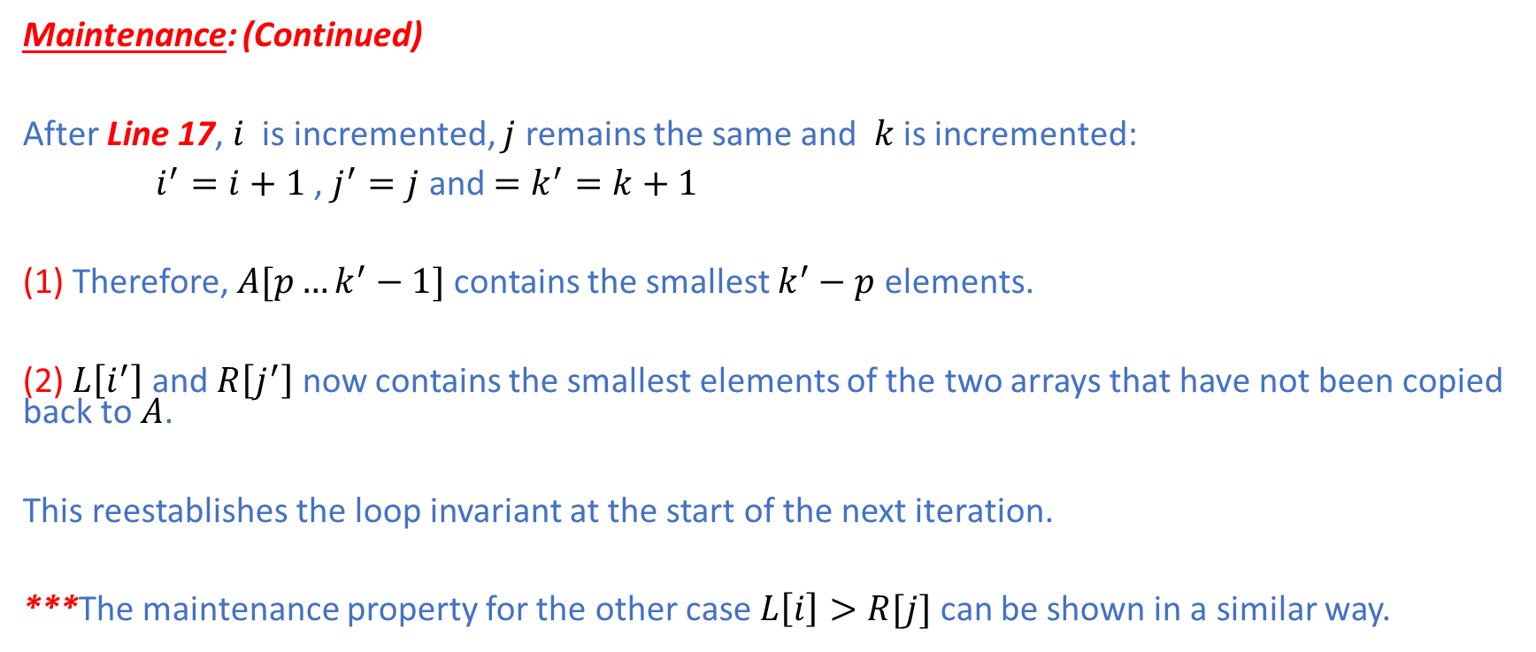
Merge Sort: Proof of Correctness
Maintenance: (Continued)
After Line 17, $i$ is incremented, $j$ remains the same and $k$ is incremented:
$i^{′}=i+1$ , $j^{′}=j$ and $=k^{′}=k+1$
(1) Therefore, $A[p…k^{′}−1]$ contains the smallest $k^{′}−p$ elements.
(2) $L\left[i^{′}\right]$ and $R\left[j^{′}\right]$ now contains the smallest elements of the two arrays that have not been copied back to $A$.
This reestablishes the loop invariant at the start of the next iteration.
***The maintenance property for the other case $L\left[i\right]>R[j]$ can be shown in a similar way.

Slide 36
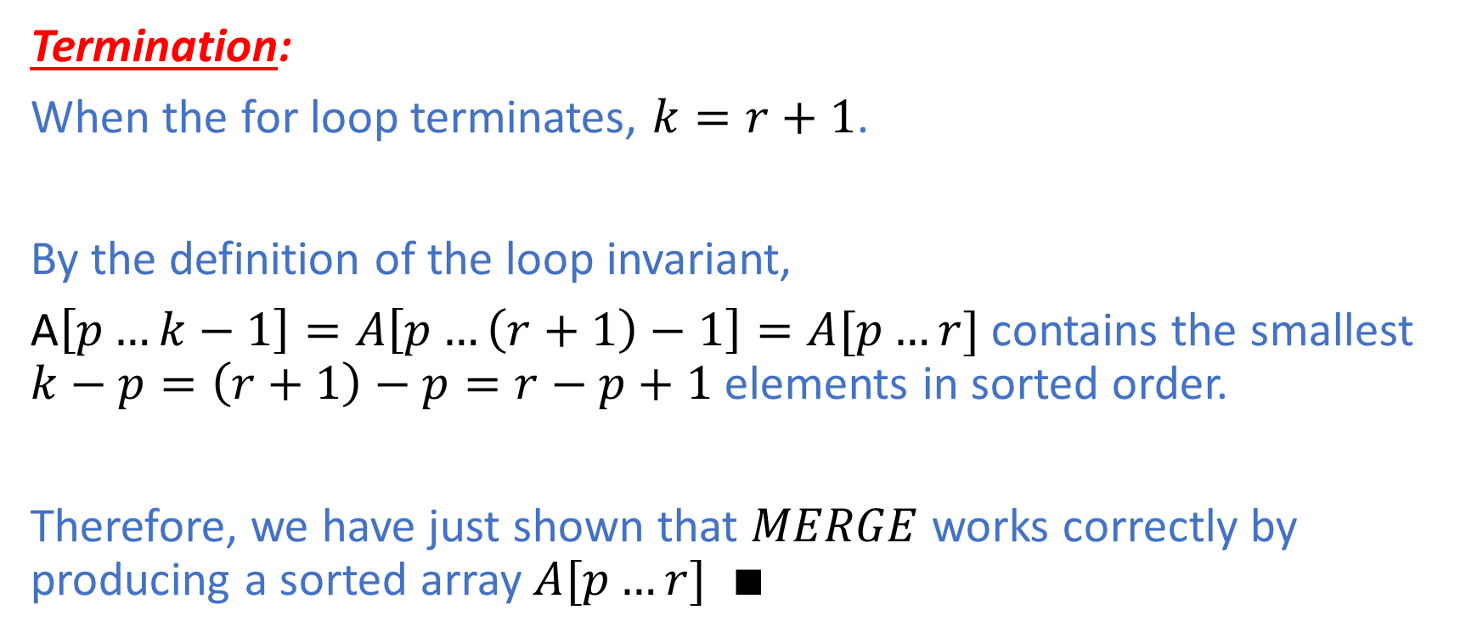
Merge Sort: Proof of Correctness
Termination:
When the for loop terminates, $k=r+1$.
By the definition of the loop invariant,
A$\left[p…k−1\right]=A\left[p…\left(r+1\right)−1\right]=A[p…r]$ contains the smallest $k−p=\left(r+1\right)−p=r−p+1$elements in sorted order.
Therefore, we have just shown that $MERGE$ works correctly by producing a sorted array $A[p…r]$ $∎$

Slide 37
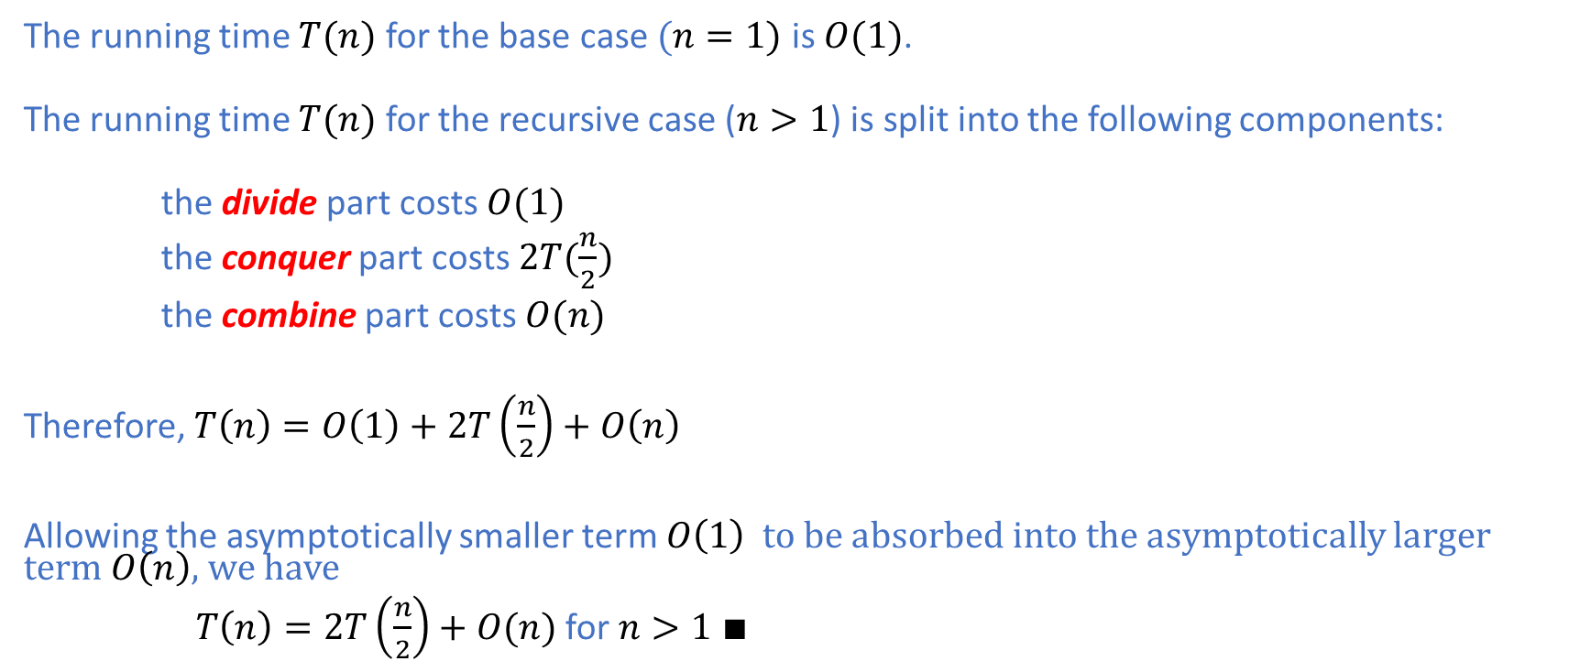
Merge Sort: Time Complexity
The running time $T(n)$ for the base case $(n=1)$ is $O(1)$.
The running time $T(n)$ for the recursive case ($n>1$) is split into the following components:
the divide part costs $O(1)$
the conquer part costs $2T(\frac{n}{2})$
the combine part costs $O(n)$
Therefore, $T\left(n\right)=O\left(1\right)+2T\left(\frac{n}{2}\right)+O\left(n\right)$
Allowing the asymptotically smaller term $O\left(1\right)$ to be absorbed into the asymptotically larger term $O\left(n\right)$, we have
$T\left(n\right)=2T\left(\frac{n}{2}\right)+O(n)$ for $n>1 ∎$

Slide 38
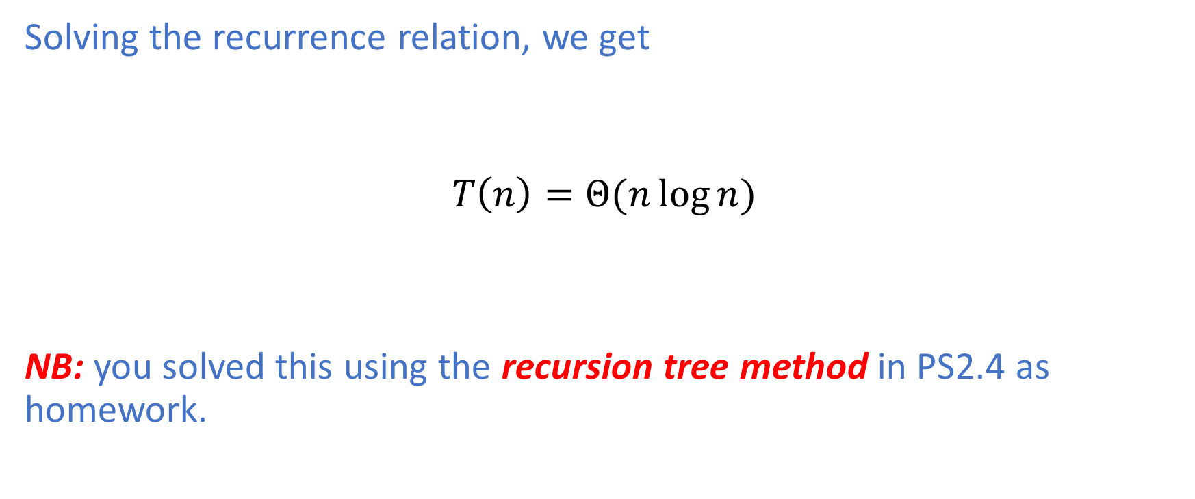
Merge Sort: Time Complexity
Solving the recurrence relation, we get
$$T\left(n\right)=Θ(n\log{n})$$
NB: you solved this using the recursion tree method in PS2.4 as homework.

Slide 39

Merge Sort: out-of-place
Merge sort needs auxiliary space $Θ(n)$ to store intermediate results during the execution of the sorting algorithm.
Therefore, it is not an in-place algorithm.

Slide 40
Summary
We have covered the following topics:
Binary Search Tree and its basic operations
Insertion Sort
Merge Sort
Correctness Proof using Loop Invariants
In the next lecture, we will cover divide and conquer.

